Slide 1
Predicting a Match For Speed Dating
Samuel Binenfeld

Slide 2
Contents
Introduction
Data Cleaning
Data Exploration
Modeling
Conclusions

Slide 3
Introduction
The Problem: The dating process is inefficient, and dates are unsuccessful far too often.
The Solution: If we can successfully predict the likelihood that two people will be a match for each other, then we can improve the success rate of dates.
How We Do It: We analyze the Speed Dating Experiment dataset from Kaggle.com to find out what makes two people a match for each other. Then, we create a machine learning model that can predict match likelihood.

Slide 4
Data Cleaning
The data set started out with 195 columns and 8,378 rows. We reduced this to 38 columns and 8,038 rows. We also reformatted some of the variables. The actions taken and the reasons why are described in this section.

Slide 5
Data Cleaning: Filtering Columns
Remove fields with significant missing data- Any field that was missing 10% or more of our data was removed.
This step removed 108 fields
Remove repetitive fields- Some fields were the same questions being asked over and over again.
This step removed 6 fields
Remove varied fields- Some fields were simply too varied to give any insight.
This step removed 6 fields
Remove after-date information- Some fields contained information gathered after the date, and we wanted to keep our analysis to information gathered pre-date.
This step removed 16 fields
Remove irrelevant fields- Fields where nothing of importance could be found were removed.
This step removed 11 fields

Slide 6
Data Cleaning: Filtering Rows
Remove dates with null values- We had to remove rows with null values because we could not make educated guesses as to what their values were.
This step removed 263 rows
Remove dates with 55 year old person- This was person was an outlier in terms of age.
This step removed 6 rows
Remove dates that had a partner who was never a primary- Every date consisted of two people, a “primary”, and a “partner”. Later, we engineer variables that contain information from both daters, so we had to remove anyone who was never a primary.
This step removed 71 rows

Slide 7
Data Cleaning: Reformat Variables
Fix “Date” and “Go Out” Variables- The rating scale for these variables was 1 through 7, with 1 being “very often”, and 7 being “never”. We found these variables to be easier to interpret when the scale was reversed, and so we subtracted each row from 8 to accomplish this.
Fix Race Variable Errors- There was an error where some participants were being recorded as the wrong race. We were able to correct these by inputting the race that the person was listed as most frequently.
Change “Other” Race from 6 to 5- Race was listed as an integer. Since there was no race with the integer 5, we changed “Other” from 6 to 5.

Slide 8
Data Exploration
Our dataset consists of 538 people, who went on a combined total of 4,019 dates
All dates were of heterosexual nature, and had one male and one female
Our variable of interest is match– A date is a match if both daters say yes to wanting to see their date again
The average match rate for all dates was 16.62%

Slide 9
Data Exploration: Gender
Males were more accepting than females
Males said yes to females 47.87% of the time
Females said yes to males 36.63% of the time

Slide 10
Data Exploration: Age
The average age was 26.25
The age distribution was slightly skewed to the right

Slide 11
Data Exploration: Age
Daters preferred to date those who were closer to their own age
We saw a decrease in match rate as the age gap between daters increased

Slide 12
Data Exploration: Race
The race distribution was not balanced
Over half were Caucasian/European
About one fourth were Asian/Pacific Islander/Asian American
1- African American
2- Caucasian/European
3- Latino/Hispanic
4- Asian/Pacific Islander/Asian-American
5- Other

Slide 13
Data Exploration: Same Race
We looked at match rates where both daters were the same race.
We saw that African Americans had the highest match rate increase– However, there were only 8 dates where both daters were African American, and so our sample size was too small. We would need to get a more racially diverse dataset to confirm this trend.
1- African American
2- Caucasian/European
3- Latino/Hispanic
4- Asian/Pacific Islander/Asian-American
5- Other

Slide 14
Data Exploration: Interests
Participants were asked to rate their level of interest on a variety of activities such as sports, movies, art, etc.
To get a look at each interest’s relationship with match rate, we performed a correlation test
Those who rated clubbing and yoga highly, had a higher match rate (on average)
Those who rated movies and tv highly, had a lower match rate (on average)

Slide 15
Data Exploration: Interests
We engineered a new variable that was a combination of both participants’ interest rating
We found that for some of the variables, match rate was higher when the combined interest variable was high
This makes sense, if we reason that people with shared interests are more likely to be a match
Here is an example with our combined interest variable for clubbing, labeled clubbing_com

Slide 16
Data Exploration: Desires and Preferences
Desires were ratings of attributes in response to the question “what do you look for in a date?”
Preferences were ratings of a diverse, mixed-bag of questions
We perform correlation tests to see the relationship between each variable and match
Those who desired their partner to be fun, had a higher match rate (on average)
Those who preferred going out and dating, also had a higher match rate (on average)
*See Appendix 1 for full list of the variables’ definitions

Slide 17
Modeling
For modeling, we go through the following steps
Recap all of our engineered features
Pre-process the data
Model the data
Perform feature selection and re-model the data
Tune our models’ parameters

Slide 18
Modeling: Feature Engineering
The following is a list of the steps taken for feature engineering:
Create interaction terms (primary rating * partner rating) for all variables in the interests, desires, and preferences categories
Create age difference variable (male age – female age)
Create age group variable that separates age into bins of [18-24, 25-30, 31-42]
Create combined age variable (primary age + partner age)
Create category variable that contains both the male and female’s race

Slide 19
Modeling: Data Pre-Processing
We split the dataset into two parts, X and y.
X- all variables except for dec, dec_o, and match
y- match
We then split each of these up into training and testing sets. Our training set uses 75% of the data and our test set is the remaining 25%.

Slide 20
Modeling: First Try
We use four different supervised learning algorithms in modeling our data
Since the overall match rate, is 16.62%, a model that predicts “no match” for every date, would be 83.38% accurate. This means we want our models to strive for higher than this.
Our first run is a disappointment, as even our highest test accuracy score barely beats 83.38%.
Model | Train Accuracy | Test Accuracy | Precision | Recall | ROC AUC | PR AUC
Random Forest | 98.47% | 84.03% | 74.51% | 10.98% | 75.32% | 47.60%
Logistic Regression | 83.69% | 82.74% | 40.00% | 0.58% | 63.44% | 29.22%
SVC | 100.00% | 82.79% | 0.00% | 0.00% | 93.54% | 88.45%
Gradient Boosting | 85.95% | 84.13% | 93.55% | 8.38% | 77.17% | 47.58%

Slide 21
Modeling: Feature Selection
Using the feature importance attribute in our Random Forest model, we take a look to see which features are performing well
We see that many of the top-performing features are our combined interest variables that we created
We will reduce the amount of features in X to only the combined interest variables, and re-model the data
Features | Importance
clubbing_com | 0.035848
yoga_com | 0.027607
date_com | 0.026963
exercise_com | 0.02595
shopping_com | 0.02567
concerts_com | 0.025075
hiking_com | 0.025022
sinc1_com | 0.02416
pid | 0.023971
exphappy_com | 0.023931

Slide 22
Modeling- Second Try
We see tremendous improvement with the Random Forest Classifier and the SVC
The next slide shows the AUC for the ROC and PR curves
Model | Train Accuracy | Test Accuracy | Precision | Recall | ROC AUC | PR AUC
Random Forest | 99.45% | 94.08% | 100.00% | 63.38% | 93.15% | 87.06%
Logistic Regression | 83.23% | 83.83% | 0.00% | 0.00% | 58.40% | 22.17%
SVC | 100.00% | 95.42% | 100.00% | 71.69% | 96.67% | 92.23%
Gradient Boosting | 85.50% | 84.88% | 86.21% | 7.69% | 69.65% | 38.54%

Slide 23
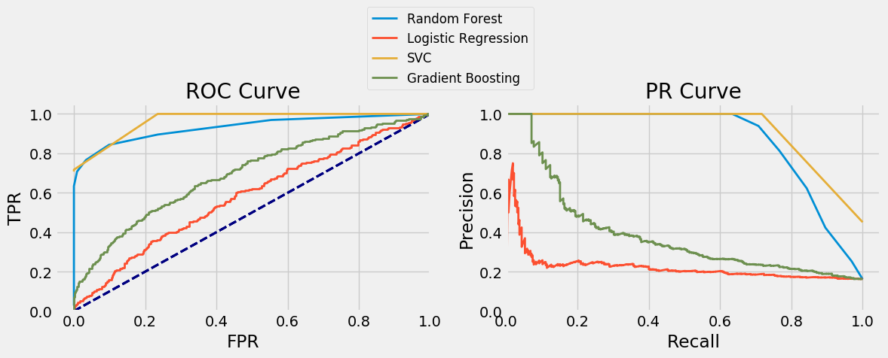
Modeling: ROC and PR Curves

Slide 24
Modeling- RF Parameter Tuning
We move forward with only the Random Forest and SVC and tune the parameters using Grid-Search CV.
We’ll start with Random Forest. On the left are the range of values we tried for each parameter, and on the right are the optimal parameters.
Ranges Attempted
n_estimators – [10, 25, 50, 75, 100]
min_samples_leaf – [1, 25, 50, 75, 100]
max_features – [.1, .25, .5, .75]
Optimal
n_estimators – 100
min_samples_leaf – 1
max_features – .1

Slide 25
Modeling- RF Parameter Tuning
We re-model the Random Forest with the tuned parameters
We see a strong improvement, especially in recall
The RF model now looks to be about as accurate as the SVC
Model | Train Accuracy | Test Accuracy | Precision | Recall | ROC AUC | PR AUC
RF (default) | 99.45% | 94.08% | 100.00% | 63.38% | 93.15% | 87.06%
RF (new params) | 100.00% | 95.52% | 100.00% | 73.13% | 96.15% | 90.30%
Improvement | 0.55% | 1.44% | 0.00% | 9.75% | 3.00% | 3.24%

Slide 26
Modeling- SVC Parameter Tuning
The following is the parameter tuning for the SVC
The gamma parameter proved to be irrelevant, so we removed it
The optimal parameters end up being the same as SVC’s default parameters
We don’t need to re-model it, since we know our previous model was already optimal
Ranges Attempted
C – [.0001,.001,.01,.1,1]
kernel – ['linear', 'rbf', 'sigmoid', 'poly']
gamma – [0.01,0.02,0.03,0.04,0.05,0.10,0.2,0.3,0.4,0.5]
Optimal
C – 1
kernel – 'rbf’
gamma – irrelevant

Slide 27
Conclusions
The most important features in predicting a match were the combined interests variables
We exceeded our goal for our models, with our highest accuracy score reaching 95.52%
The best performing models were the Random Forest Classifier with tuned parameters, and the SVC with default parameters
Both models performed well in test accuracy score and AUC of PR Curve, so we are comfortable using either one

Slide 28
Appendix 1

Slide 29
Appendix 1 cont.

Slide 30
Appendix 1 cont.

Slide 31
Appendix 1 cont.

Slide 32
Appendix 1 cont.

